Slide 1
10/3/2022

Slide 2

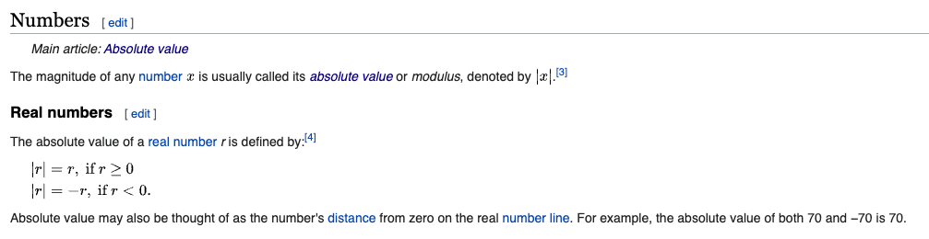

Slide 3
3.1
Boolean Expressions

Slide 4
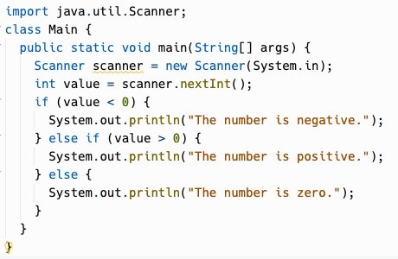
Can you identify all of the
Expressions
Which are Boolean Expressions?
Statements
Blocks
Formal parameters
Actual parameters

Slide 5
Equality Operators
x == y | true if x is equal to y, false otherwise
x != y | true if x is not equal to y, false otherwise
Keep in mind that you must use "==", not "=", when testing if two values are equal.
= is the assignment operator and will assign the value of y to x!

Slide 6
Relational Operators
x > y | true if x is greater than y, false otherwise
x < y | true if x is less than y, false otherwise
x >= y | true if x is greater than or equal to y, false otherwise
x <= y | true if x is less than or equal to y, false otherwise
Tip: To remember >= and <=, think of it as the order in which you say it. Greater than (>) or equal to (=)

Slide 7
Relational Operators
x > y | true if x is greater than y, false otherwise
x < y | true if x is less than y, false otherwise
x >= y | true if x is greater than or equal to y, false otherwise
x <= y | true if x is less than or equal to y, false otherwise
These don't work on objects, such as Strings! This is where you use the String.compareTo method.
(compareTo isn't part of Object like equals - it comes from the Comparable interface.)

Slide 8
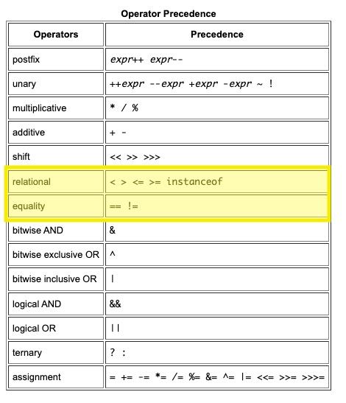
Are ==, != relational operators?
CS Awesome talks about == and != as relational operators. Are they?
Yes and no. Wikipedia does define equality operators as being relational operators.
But Java does define equality operators to have lower precedence than the other relational operators, so they behave slightly differently.
x < 2 == y > 5 is (x < 2) == (y > 5)

Slide 9
Modulo Operator (%)
x % y | returns the remainder of dividing x by y
This is NOT a boolean operator, but it's a handy one frequently used with operators like ==. % works on integers but also on floats/doubles in Java.
One use is checking whether a number is even or odd.
x % 2 == 0 means x is even
x % 2 == 1 means x is odd
You can use it to check if a number is an even multiple of another:
x % y == 0 means x is a multiple of y (can be divided by y with a remainder of 0)

Slide 10
3.2, 3.3
if-else statements

Slide 11
if syntax
Flowchart of if
if (boolean expression)
then-statement
Does boolean expression evaluate to true?
Example:
Yes
if (age >= 18) { System.out.println("You are eligible to vote!"); }
No
Execute then-statement
Legal, but not recommended:
if (age >= 18) System.out.println("You are eligible to vote!");
Next statement after if
then-statement can be any statement, and a { block } is a statement.
It's recommended to always use blocks with if.

Slide 12
if-else syntax
Flowchart of if…else
Does boolean expression evaluate to true?
if (boolean expression)
then-statement
else
else-statement
No
Yes
Execute then-statement
Execute else-statement
The if statement has an optional else clause.
Example:
if (age >= 18) {
System.out.println("You are eligible to vote!");
} else {
System.out.println("You are too young to vote!");
}
Next statement after if…else

Slide 13
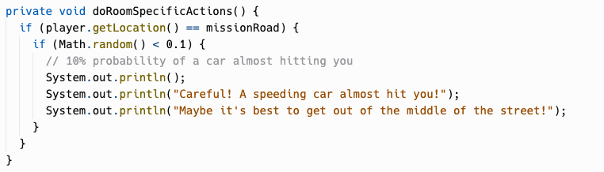
Nested If-Statements
if (boolean expression) {
if (boolean expression) {
if (boolean expression) {
<statement>;
<statement>;
…
} else {
<statement>;
<statement>;
…
}
}
} else {
<statement>;
<statement>;
…
}

Slide 14
Dangling Else
int x = 0;
if (x >= 0)
if (x > 0)
System.out.println(“x is positive”);
else
System.out.println(“x is negative”);
is paired with this if
this else
Prints “x is negative”!
The else clause will always be a part of the closest if statement if in the same block of code regardless of indentation…
Unless you use {}!

Slide 15
3.4
Multi-Selection : else-if

Slide 16
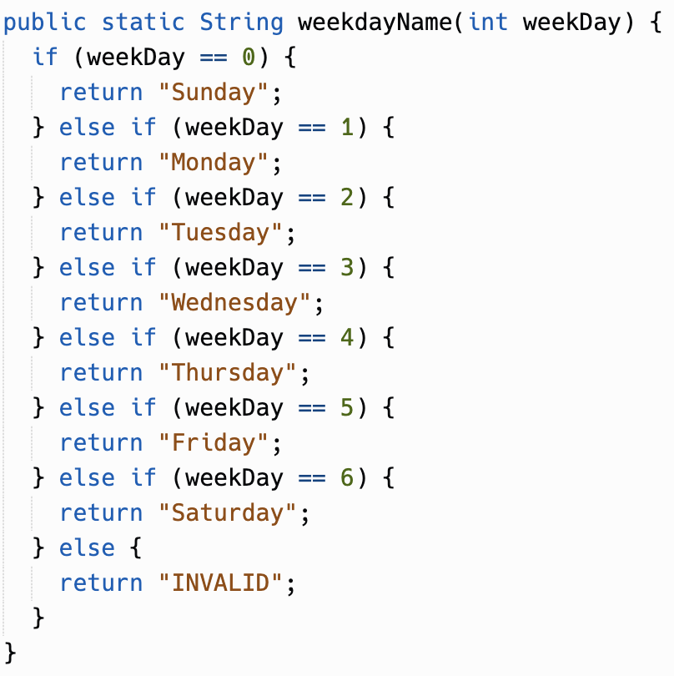
else-if syntax
if (boolean expression 1)
statement1
else if (boolean expression 2)
statement2
else if (boolean expression 3)
statement3

Slide 17
else-if syntax
Flowchart of else-if
Does boolean expression 1 evaluate to true?
if (boolean expression 1)
statement1
else if (boolean expression 2)
statement2
else if (boolean expression 3)
statement3
No
Yes
Does boolean expression 2 evaluate to true?
No
Yes
Does boolean expression 3 evaluate to true?
Yes
Execute statement1
Execute statement2
Execute statement3

Slide 18
3.5
Compound Boolean Expressions

Slide 19
Logical Operators
Logical And
p && q
Evaluates boolean expressions p and q.
Evaluates to true if p and q are both true, false otherwise.
if (sunny && warm) { … }
Logical Or
p || q
Evaluates boolean expressions x and y.
Evaluates to true if p or q are true, false otherwise.
if (christmas || halloween) { … }
Logical Not
!p
Evaluates boolean expression p.
Evaluates to true if p is false.
Evaluates to false if p is true.
if (!day.equals("Sunday")) { … }
Why p and q? In logic textbooks, the "default" names for logical propositions are p and q.

Slide 20
Truth Table - &&
Truth Table - ||
Truth Table - !
p | q | p && q
true | true | true
true | false | false
false | true | false
false | false | false
p | q | p || q
true | true | true
true | false | true
false | true | true
false | false | false
p | !p
true | false
false | true

Slide 21
Short-Circuit Evaluation with &&
Does p evaluate to true?
No
Yes
p && q
Does q evaluate to true?
No
Yes
true
false

Slide 22
Short-Circuit Evaluation with ||
Does p evaluate to true?
Yes
No
p || q
Does q evaluate to true?
Yes
No
false
true

Slide 23
3.6
Equivalent Boolean Expressions

Slide 24
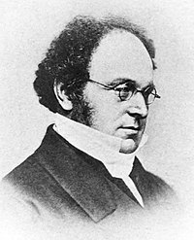
DeMorgan's Laws
These rules can simplify boolean expressions to make them easier to read or interpret.
!(a && b) is equivalent to !a || !b
!(a || b) is equivalent to !a && !b

Slide 25
De Morgan's Laws: Example
YOU: I'm leaving for school!
MOM: Let's make sure you have everything.
MOM: Do you have both your phone and your lunch?
(is phone && lunch true?)
YOU: No. !(phone && lunch) is true
MOM: What are you missing, your phone? Your lunch? Both?
!phone || !lunch is true

Slide 26
De Morgan's Laws: Truth Tables
!(phone && lunch) = !phone || !lunch
phone | lunch | !(phone && lunch) | !phone || !lunch
F | F | !(F && F) → !F → T | !F || !F → T || T → T
F | T | !(F && T) → !F → T | !F || !T → T || F → T
T | F | !(T && F) → !F → T | !T || !F → F || T → T
T | T | !(T && T) → !T → F | !T || !T → F || F → F

Slide 27
De Morgan's Laws: Example
!(a && b) = !a || !b
You must do pull-ups AND run a mile to complete the fitness test.
if (!(completedPullUps && completedOneMileRun)) { System.out.println(“You are not yet done with your fitness test!"); }
is the same as
if (!completedPullUps || !completedOneMileRun) { System.out.println(“You are not yet done with your fitness test!”); }

Slide 28
De Morgan's Laws: Example
!(a && b) = !a || !b
You must sign a waiver AND show your ID at the front desk to come in to the gym.
if (!(signedWaiver && shownID)) { System.out.println(“You must sign a waiver and show ID to enter gym."); }
is the same as
if (!signedWaiver || !shownID) { System.out.println(“You must sign a waiver and show ID to enter gym.”); }

Slide 29
De Morgan's Laws: Example
!(a || b) = !a && !b
You must show a paper vaccine card or vaccination proof on your phone, to enter.
if (!(hasVaccinePaperCard || hasVaccineProofOnPhone)) { System.out.println(“ERROR: Proof of vaccination required."); }
is the same as
if (!hasVaccinePaperCard && !hasVaccineProofOnPhone) { System.out.println(“ERROR: Proof of vaccination required.”); }

Slide 30
De Morgan's Laws: Example
!(a || b) = !a && !b
You can come to our concerts if you haven't jumped on stage or yelled really loud.
if (!(hasYelledLoud || hasJumpedOnStage)) { System.out.println(“You may enter the concert venue"); }
is the same as
if (!hasYelledLoud && !hasJumpedOnStage) { System.out.println(“You may enter the concert venue”); }

Slide 31
De Morgan's Laws: Truth Tables
!(a && b) = !a || !b
a | b | !(a && b) | !a || !b
F | F | !(F && F) → !F → T | !F || !F → T || T → T
F | T | !(F && T) → !F → T | !F || !T → T || F → T
T | F | !(T && F) → !F → T | !T || !F → F || T → T
T | T | !(T && T) → !T → F | !T || !T → F || F → F

Slide 32
De Morgan's Laws: Truth Tables
!(a || b) = !a && !b
a | b | !(a || b) | !a && !b
F | F | !(F || F) → !F → T | !F && !F → T && T → T
F | T | !(F || T) → !T → F | !F && !T → T && F → F
T | F | !(T || F) → !T → F | !T && !F → F && T → F
T | T | !(T || T) → !T → F | !T && !T → F && F → F

Slide 33
Negated Relational Expressions
For negated relational expressions, you can flip the operator and remove the !
!(c == d) is equivalent to (c != d)
!(c != d) is equivalent to (c == d)
!(c < d) is equivalent to (c >= d)
!(c > d) is equivalent to (c <= d)
!(c <= d) is equivalent to (c > d)
!(c >= d) is equivalent to (c < d)
Example:
Simplify !(x > 2 && y < 4)
Apply !(a && b) == !a || !b
!(x > 2) || !(y < 4)
Apply !(c > d) == (c <= d)
(x <= 2) || !(y < 4)
Apply !(c < d) == (c >= d)
x <= 2 || y >= 4

Slide 34
3.7
Object Equality

Slide 35
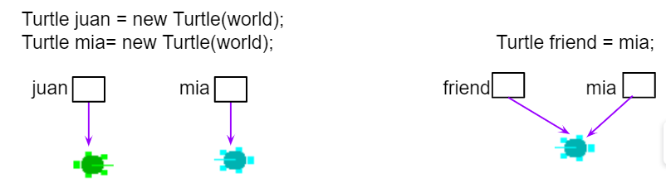
Object Equality
For object types, == and != compare whether the two sides are references to the same object… not whether anything else about the objects are equal, such as the characters in two Strings.
For Strings, remember to use equals() and not the == or != operators.

Slide 36
null means nothing is pointed to
String s; is a reference variable of type String.
A String reference, like all object references, either points to a String object instance, or is null
String s;
String s;
s
null
s = "Hello, world!"; ← s started out null, but now points to a legit string
s
"Hello, world!"
String instance

Slide 37
NullPointerException
If you try usings methods or attributes of a null object reference, Java throws NullPointerException:
String s;
if (s.indexOf("a") >= 0) {
System.out.println(s + " contains an a"); ← throws NullPointerException
}
Some exceptions are not bugs in your program, like an exception thrown if the network is down.
But a NullPointerException usually means you need to fix your code.

Slide 38
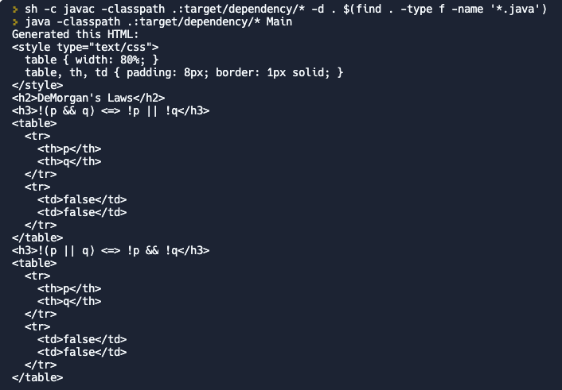
Practice!
Repl.it: deMorgan

